Slide 1
Chapter 7 Runtime Environments
~汇编

Slide 2
7.3 Stack-based runtime environments
For a language, in which
  Recursive calls are allowed
  Local variables are newly allocated at each call
  AR allocated in a stack-based fashion rather than statically.
Each procedure may have several different activation records on the call stack at one time.

Slide 3
7.3.1 Stack-Based Environments w/o Local Procedures
In a language where all procedures are global (such as C language), the stack-based environment requires two things
  (1) Frame pointer or fp, allowing access to local variable within current AR. Another alias is control link or dynamic link, given that it points to fp of the immediately preceding AR.
  (2) Stack pointer or sp, pointing to the last location allocated on the stack.

Slide 4
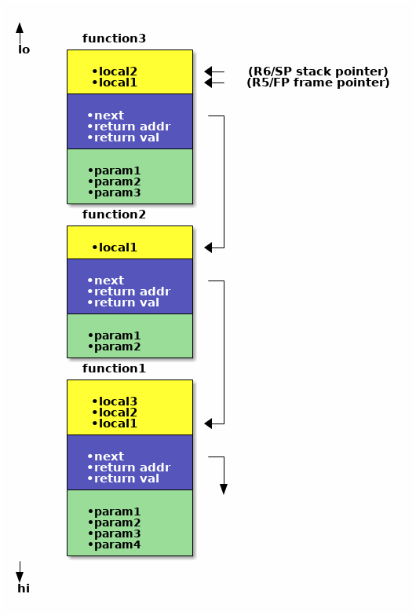
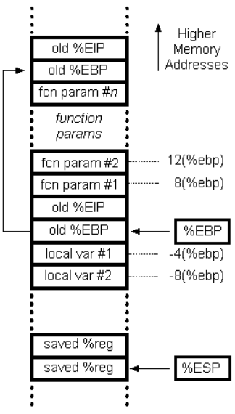
A General AR
7.3.1 Stack-Based Environments w/o Local Procedures
param
fp
rv
Saved machine status
Local
Temporaries

Slide 5
Example
void g(int m)
{int y=m-1;
if (y>0)
{ f(y);
x--;
g(y);
}
}
main( )
{g(x);
return 0;
}
int x=2;
void g(int);/*prototype*/
void f(int n)
{ static int x =1 ;
g(n);
x--;
}

Slide 6
Example:
(a) Runtime environment of the above program during the second call to g
int x=2;
void g(int);/*prototype*/
void f(int n)
{
static int x=1;
g(n);
x--;
}
void g(int m)
{
int y=m-1;
if (y>0)
{ f(y);
x--;
g(y);
}
}
main( )
{
g(x);
return 0;
}
x : 2 x (from f) :1 | Global/static area
 | Activation record of main
m:2 Control link Return address y :1 | Activation record of Call to g
n:1 Control link Return address | Activation record of Call to f
m:1 Control link Return address y: 0 | Activation record of Call to g
Free space
fp
sp

Slide 7
(b) Runtime environment of the above program during the third call to g
x:1 Global/static area
x(from f):0
Activation record of main
m:2 Activation record of
Control link call to g
Return address
y:1
m:1 Activation record of
Control link call to g
Return address
y:0
Free space
fp
sp

Slide 8
7.3.1 Stack-Based Environments w/o Local Procedures
Activation tree: a useful tool for the analysis of complex calling structures
main()
main()
# include <stdio.h>
int x,y;
int gcd(int u,int v)
{
if (v==0) return;
else return gcd(v,u,%v);
}
main()
{
scanf(“%d%d”,&x,&y);
printf(“%d\n”,gcd(x,y));
return 0;
}
gcd(15,10)
g(2)
gcd(10,5)
f(1) g(1)
gcd(5,0)
g(1)

Slide 9
7.3.1 Stack-Based Environments w/o Local Procedures
parameters and local variable can be found by offset from the current frame pointer.
In most language, the offset can be statically computed by the compiler.
Example 7.4 C procedure：
void f(int x, char c)
{ int a[10];
double y;
…
}

Slide 10
7.3.1 Stack-Based Environments w/o Local Procedures
地址增长方向
Name Offset
x +5
c +4
a -24
y -32
x
offset of x
c
offset of c
fp
Control link
Return address
C procedure
void f(int x, char c)
{ int a[10];
double y;
…
}
a[9]
……
a[1]
a[0]
offset of a
y
offset of y

Slide 11
The calling sequence
7.3.1 Stack-Based Environments w/o Local Procedures
(1)Compute the arguments and store them in their correct positions in the new activation record of the procedure.
(2) Store the fp as the control link in the new activation record;
(3) Change the fp so that it points to the beginning of the new activation record;
(4) Store the return address in the new activation record;
(5) Perform a jump to the code of the procedure to be called.

Slide 12
When a procedure exits
7.3.1 Stack-Based Environments w/o Local Procedures
(1) Copy the fp to the sp.
(2) Load the control link into the fp.
(3) Perform a jump to the return address.
(4) Change the sp to pop the arguments.

Slide 13
Dealing with arguments
7.3.1 Stack-Based Environments w/o Local Procedures
arguments may vary both in number and in type.
(1) The number of arguments in a call may vary from call to call.
(2) The size of an array parameter or a local array variable may vary from call to call
printf(“%d%s%c”,n,prompt,ch) Has four arguments
printf(“Hello, world\n”) Has only one argument

Slide 14
7.3.1 Stack-Based Environments w/o Local Procedures
Dealing with arguments
C compiler typically deal with this by pushing the arguments to a call in reverse order onto the runtime stack. The first parameter is always located at a fixed offset from the fp in the implementation described above.
Another option is to use a processor mechanism such as ap(argument pointer) in VAX architecture.

Slide 15
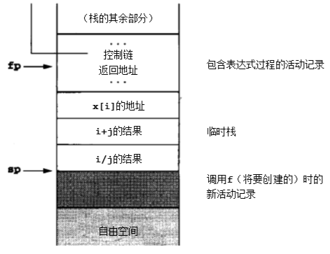
Local Temporaries and Nested Declarations
7.3.1 Stack-Based Environments w/o Local Procedures
Local temporaries are partial results of computations that must be saved across procedure calls, for example:
x[i] = (i + j) *(i/k + f(j))
The three partial results need to be saved across the call to f:
The address of x[i];
The sum i+j;
The quotient i/k;

Slide 16
7.3.1 Stack-Based Environments w/o Local Procedures
Nested declarations present a similar problem.
Void p( int x, double y)
{ char a;
int i;
…
A: {double x;
int j;
…
}
…
B:{char *a;
int k;
…
}
…
}
/* 作用域仅仅覆盖着其所在块 (也就是说向上直到下一个闭合的括号)的局部声明 */

Slide 17
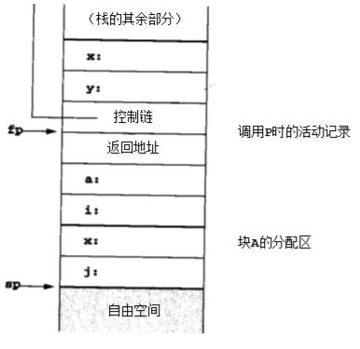
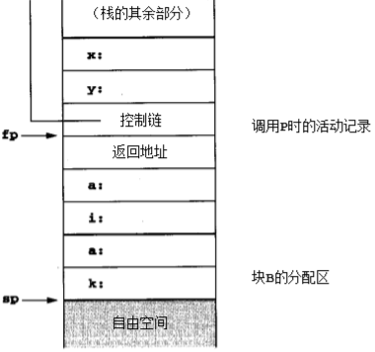
7.3.1 Stack-Based Environments w/o Local Procedures
The nested local declarations do not need to be allocated until entered;
The declarations of A and B do not need to be allocated simultaneously.
A simple method is to treat them in a similar way to temporary expression.

Slide 18
7.3.2 Stack-Based Environment & Local Procedures
(Non-local and Non-global) references
Motivation: 去外层作用域找变量
To solve the above problem about variable access, we add an extra piece of bookkeeping information called the access link to each AR.

Slide 19
7.3.2 Stack-Based Environment w/ Local Procedures
Access link represents the defining environment of the procedure; access link is sometimes also called the static link.
  Offset can be computed at compile-time
Control link represents the calling environment of the procedure.

Slide 20
7.3.2 Stack-Based Environment w/ Local Procedures
TGT: find n using AR
program nonlocalRef;
procedure p;
var n: integer; (* local to p *)
procedure q; (* local proc *)
begin
(* a reference to n is
non-local and non-global *)
end; (*q*)
procedure r(n: integer);
begin
q;
end; (*r*)
begin (*p*)
n :=1;
r(2);
end; (*p*)
begin (*main*)
p;
end.

Slide 21
7.3.2 Stack-Based Environment w/ Local Procedures
Activation record of
main program
<no access link>
Control link
Return address
n:1
Activation record of
Call to p
n:2
Access link
Control link
Return addres
Activation record of
Call to r
>兄弟
Access link
Control link
Return addres
Activation record of
Call to q
fp
sp
Free space

Slide 22
7.4 DYNAMIC MEMORY
Ref text p284+ for dynamic scope, nest lv attr;
Ref text p287 for lambdas
Limitation of stack-based environment:
  if a reference to caller’s locals is returned to the caller, then dangling reference is imminent.
E.g.
    int * dangle(void) {
    int x;
    return &x;
    }
auto addr = dangle( ); // cause addr to point to an unsafe location in the activation stack.

Slide 23
7.4.1 Fully Dynamic Runtime Environments
w/ garbage collection:
  the tracking of references during execution .
  the ability to find and deallocate inaccessible areas of memory at arbitrary times during execution.

Slide 24
7.4.1 Fully Dynamic Runtime Environments
In fully dynamic environment, the basic structure of activation record remains the same.
When control is returned to the caller, the exited AR remains in memory, to be de-allocated at some later time.

Slide 25
7.4.2 Dynamic Memory in Object-Oriented Languages
OO languages require special mechanisms in the runtime environment to implement their added features: Objects, methods, inheritance, and dynamic binding.

Slide 26
7.4.2 Dynamic Memory in Object-Oriented Languages
An object in memory can be viewed as a cross between a traditional record structure and an activation record.
the instance variable ( data members ) as the fields of the record .

Slide 27
7.4.2 Dynamic Memory in Object-Oriented Languages
One straightforward mechanism :
  for initialization code to copy all the currently inherited features ( and methods) directly into the record structure. This is extremely wasteful of space.
2.keep a complete description of the class structure in memory at each point during execution.
  inheritance maintained by superclass pointers
  all method pointers kept as fields in the class structure.

Slide 28
7.4.2 Dynamic Memory in Object-Oriented Languages
3. compute the list of code pointers for available methods of each class , and store this in ( static) memory as a virtual function table ( in c++ ).
  it can be arranged so that each method has a predictable offset
  a traversal of the class hierarchy with a series of table lookups is no longer necessary.
  Each object contains a pointer to the appropriate virtual function table.

Slide 29
7.4.3 Heap Management
A standard method for maintaining the heap and implementing these functions:
(1) a circular linked list of free blocks.
(2) memory is taken by malloc.
(3) memory is returned by free.
drawbacks:
  (1) The free operation can not tell if the pointer is legal or not.
  (2) Care must be taken to coalesce blocks, otherwise the heap can quickly become fragmented.

Slide 30
7.4.3 Heap Management
memptr
next
(allocated header)
next
Header
usedsize
free space
freesize
used space
free space
Another impl: use a circular linked list data structure that keeps track of both allocated and free block.

Slide 31
7.4.3 Heap Management
(allocated header)
next
used
used
memptr
used
(allocated header)
next
memptr
free
used
free
used
free

Slide 32
7.4.3 Heap Management
#define MEMSIZE 8096 /* change for different sizes */
typedef double align;
typedef union header {
struct {
union header *next;
unsigned usedsize;
unsigned freesize;
} s;
align a;
} header;
static header mem[MEMSIZE]; // the heap
static header *memptr=NULL; // last allocated header

Slide 33
7.4.3 Heap Management
void *malloc(unsigned nbytes)
{ header *p, *newp;
// 上调 nbytes 到整数个 header 大小，再分配一个 header 管理这块内存
unsigned nunits;
nunits = (nbytes+sizeof(header)-1)/sizeof(header) + 1;
// init
if (memptr == NULL)
{ memptr->s.next = memptr = mem; // circ
memptr->s.usedsize = 1;
memptr->s.freesize = MEMSIZE-1;
}
// find p pointing to the header managing big enough block
for(p=memptr; (p->s.next!=memptr)&&(p->s.freesize<nunits); p=p->s.next);

Slide 34
7.4.3 Heap Management
if (p->s.freesize < nunits) return NULL; /* no block big enough */
newp = p + p->s.usedsize; // start of free space
// create a new header
newp->s.usedsize = nunits;
newp->s.freesize = p->s.freesize – nunits;
newp->s.next = p->s.next;
// insert into the linked list
p->s.freesize=0;
p->s.next = newp;
memptr = newp;
// client has the space after new header
return (void *) (newp+1);
}

Slide 35
7.4.3 Heap Management
void free(void *ap) {
header *bp, *p, *prev;
bp = (header *)ap – 1; // the bookkeeping header
// trying to reclaim the block
for (prev=memptr, p=memptr->s.next;
(p!=bp) && (p!=memptr); prev=p, p=p->s.next);
if (p!=bp) return; /* ap is not allocated by us */
// p == bp: coalesce blocks
prev->s.freesize += p->s.usedsize + p->s.freesize;
prev->s.next = p->s.next;
memptr = prev;
}

